Slide 1
Astro-Strike Simulator
Team members
Team Name: Phoenix Trio
Event: 2025 NASA Space Apps Challenge
Challenge Selected: Meteor Madness
Guru Raj Patil
Harsha Bharadwaj
Thrisha R
Title: Astro-Strike Simulator
Subtitle: Visualize, Simulate, Mitigate: Understanding Near-Earth Object Threats

Slide 2
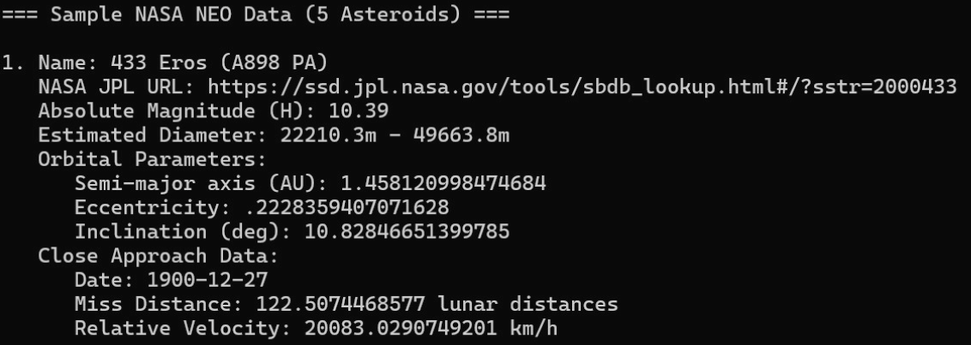
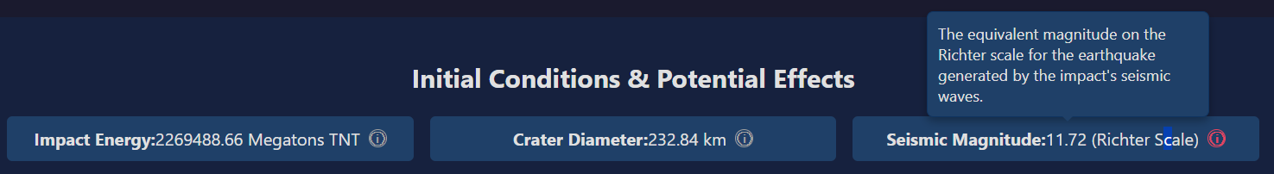
Problem Statement
Making Celestial Threats Understandable
Core Question: NASA provides vast amounts of data on Near-Earth Objects, but how can we make the potential risks feel real and understandable to everyone?
There is a need for an accessible tool that connects asteroid data (size, speed, orbit) to tangible, real-world consequences.
Existing tools often lack interactive mitigation scenarios, leaving a gap in planetary defense education.

Slide 3
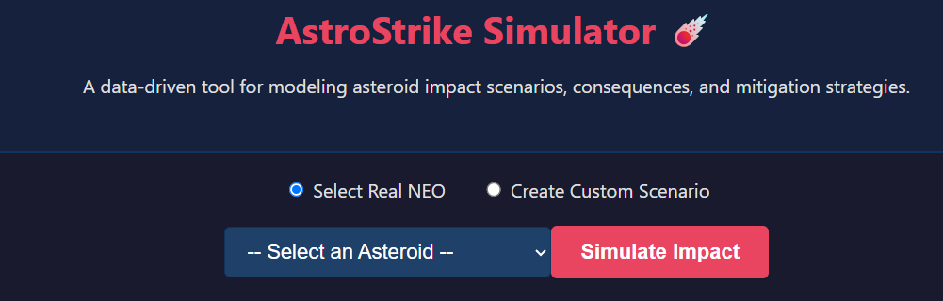
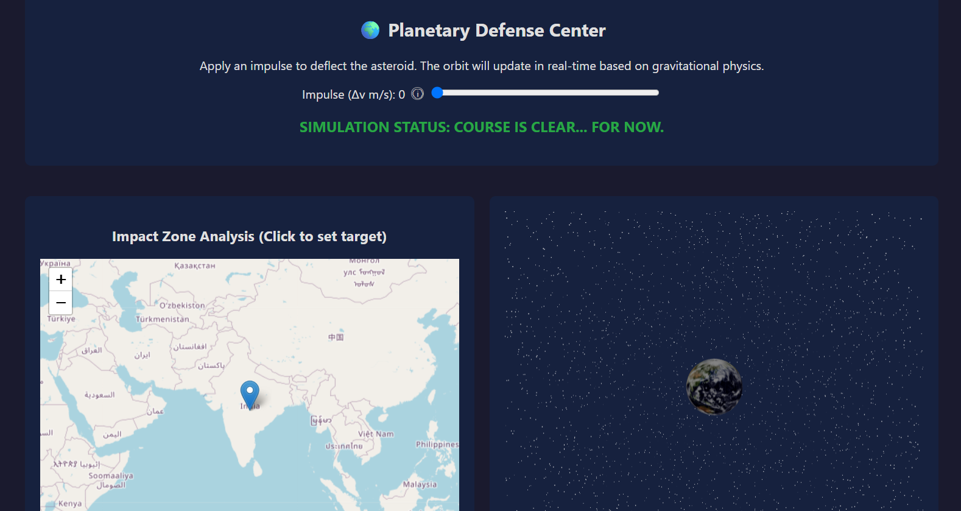
Our Solution
Your Hands-On Planetary Defense Hub
An interactive web tool that lets anyone simulate asteroid impact scenarios using real scientific models and data.
The User Experience: We put you in control.
Choose a real asteroid or design your own
set an impact location
witness the consequences unfold.
Participate in planetary defense: Deflect the threat using kinetic impactors.

Slide 4
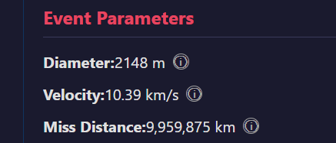
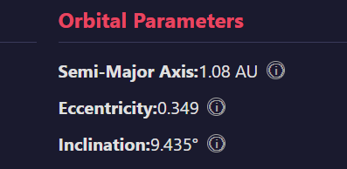
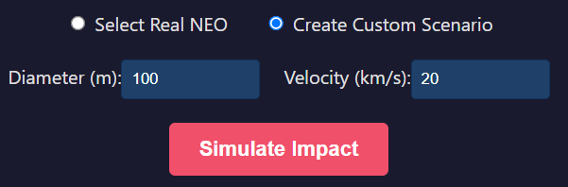
The Power of NASA's Open Data
How it Works: Our simulator is powered directly by NASA's Near-Earth Object (NEO) API via our Flask backend.
Every asteroid you select comes with real-world orbital and physical data.
From Data to Simulation:
We use the asteroid's diameter and velocity to calculate its kinetic energy.
The app automatically computes impact energy, crater size, and seismic magnitude based on established physics formulas.
Its orbital parameters are used to model a realistic trajectory in our 3D simulation.
Customizable Parameters: Create hypothetical scenarios by defining an asteroid's diameter and velocity to see how these variables affect the outcome.

Slide 5
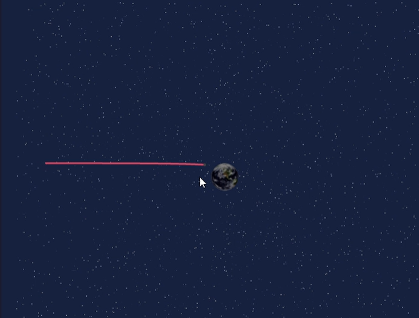
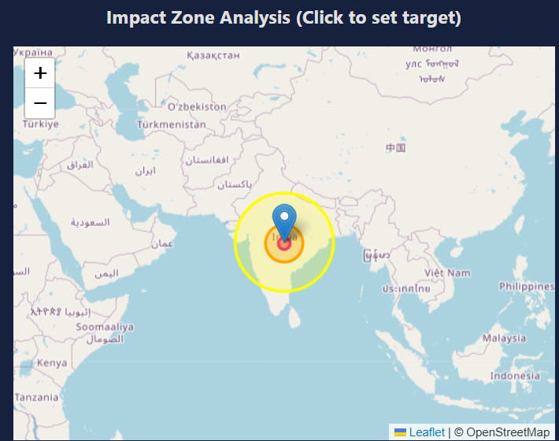
Visualizing the Impact: Two Views
See the Impact from a Cosmic View and Map View
User Experience: The moment of impact is visualized from two perspectives.
3D Orbital Simulation: A real-time Three.js canvas displays the asteroid's trajectory, its gravitational curve around Earth, and the result of mitigation efforts.
2D Impact Map: Simultaneously, a Leaflet interactive map displays the impact zone, with color-coded rings showing the scale of the crater and subsequent seismic shockwaves.
This is a GIF (slide show)

Slide 6
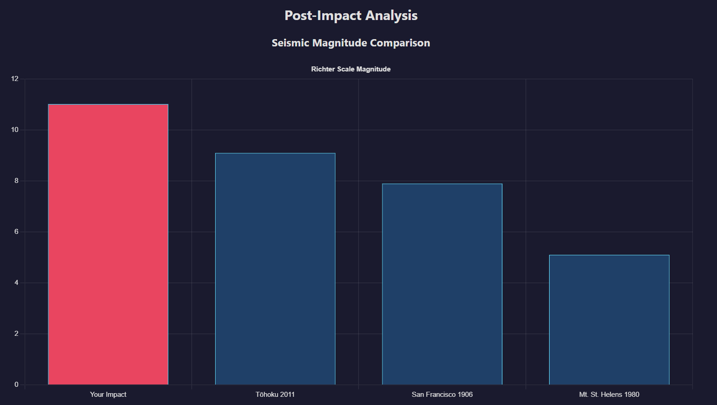
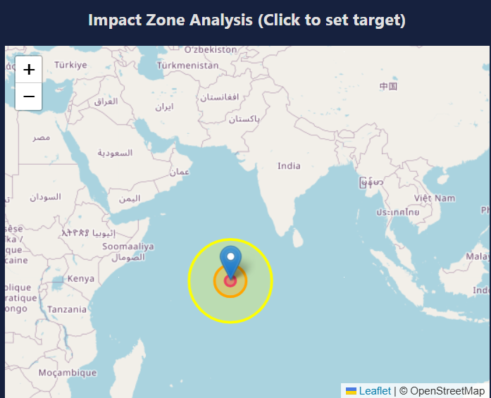
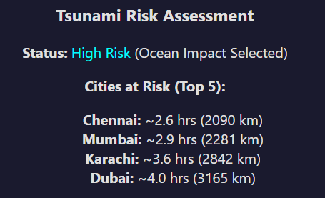
Analyzing the Aftermath
Understanding the Consequences
User Experience: After the impact, the user receives an immediate, easy-to-read "Post-Impact Analysis" report.
Seismic Comparison: A bar chart contextualizes the event by comparing its seismic magnitude to famous earthquakes and volcanic eruptions.
Tsunami Risk Assessment: For ocean impacts, the tool identifies major coastal cities at risk and estimates the tsunami's travel time, turning abstract data into an urgent, human-centric story.

Slide 7
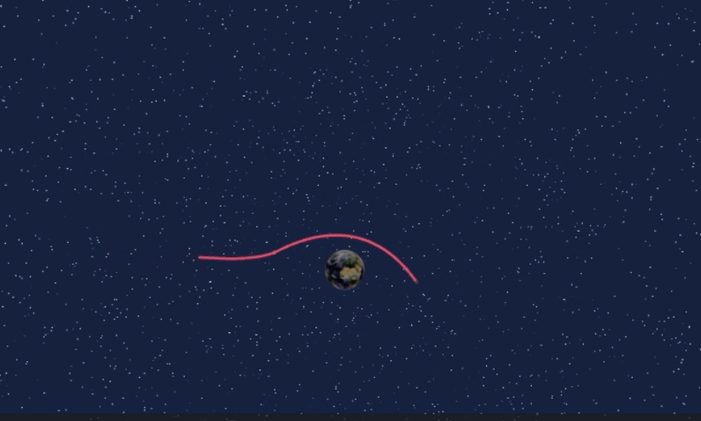
Your Mission: Defend Earth
From Observer to Defender
This is a GIF (slide show)
The User's Role: AstroStrike Simulator's most powerful feature is putting the user in control of mitigation.
How it Works: Apply a small change in velocity with the "Impulse" slider and watch in real-time as the asteroid's trajectory shifts from a catastrophic impact to a safe fly-by.
Mitigation Simulator: Users can actively try to avert disaster by applying a velocity change (delta-v) to the asteroid using a simple slider.
Our Impact: By making science interactive, we empower everyone to understand not just the problem of asteroid threats, but also the reality of the solutions.

